Slide 1
Persona Verification
Aaron Childress

Slide 2
Agenda
Assess Overall Model Effectiveness
Assess Individual Check Effectiveness
Highlight Meaningful End User Trends
Summary

Slide 3
Model Effectiveness
Overall & Individual Checks

Slide 4
Approach
I decided to focus on records where the ground truth was observable (no image quality issues). This represents ~86% of the data. Further, this is an imbalanced classification problem, so I used relevant measures to score the model – precision and recall.

Slide 5
Model Goal: Minimize False Negatives
 | Precision | Recall | F1-score | Support
No Fraud | 0.98 | 0.60 | 0.74 | 793
Fraud | 0.16 | 0.87 | 0.27 | 71
Accuracy |  |  | 0.62 | 864
Macro Avg | 0.57 | 0.74 | 0.51 | 864
Weighted Avg | 0.91 | 0.62 | 0.70 | 864
The least desirable outcome is an incidence of fraud that is predicted as not fraud
In this respect the model does a better job than the accuracy score would suggest
87% of the positive fraud observations were correctly classified

Slide 6
Best Individual Check Surprises
Tamper detection appears to be a great predictor when looking at all observations…
…However, when looking only at fraud instances, barcode detection moves from last to first

Slide 7
End User Analysis
Device, Calendar & Location

Slide 8
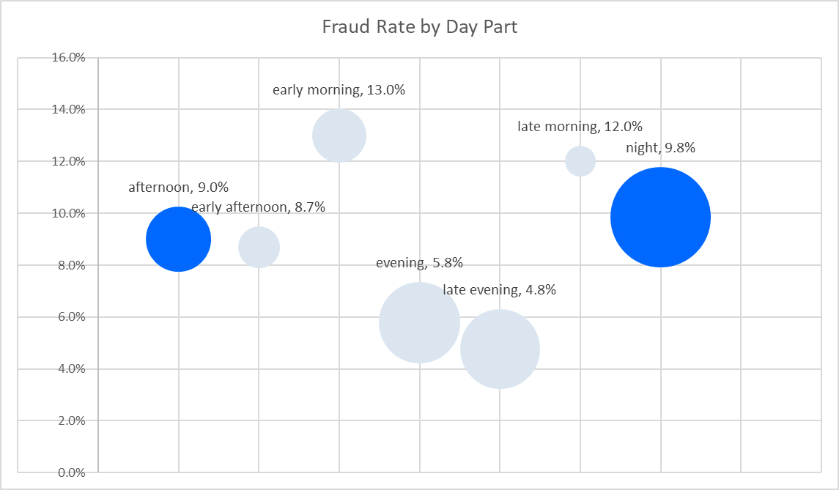
Isolate Day Parts to Address Spikes
While early and late morning have the highest fraud rates, it could be more impactful to focus on night and afternoon as there’s larger volume.

Slide 9
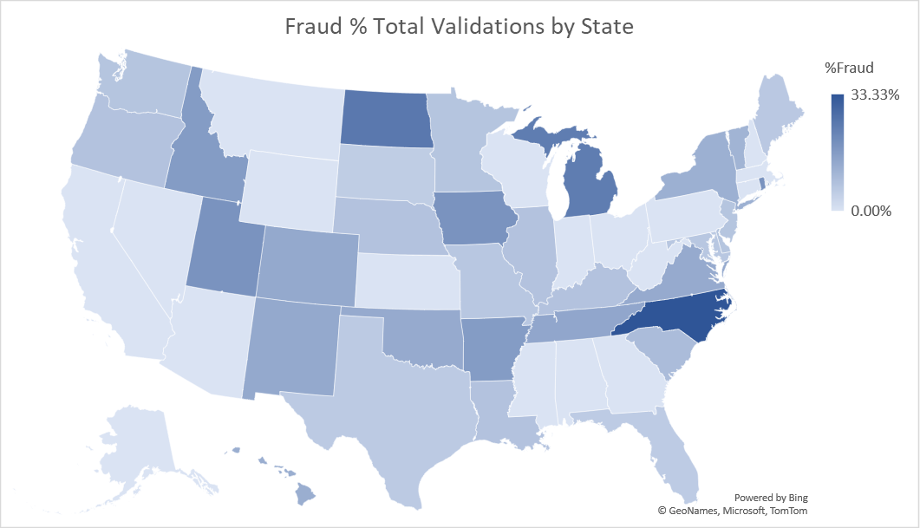
DC and NC have the highest fraud rates at 33%; ND and MI come in at ~25%

Slide 10
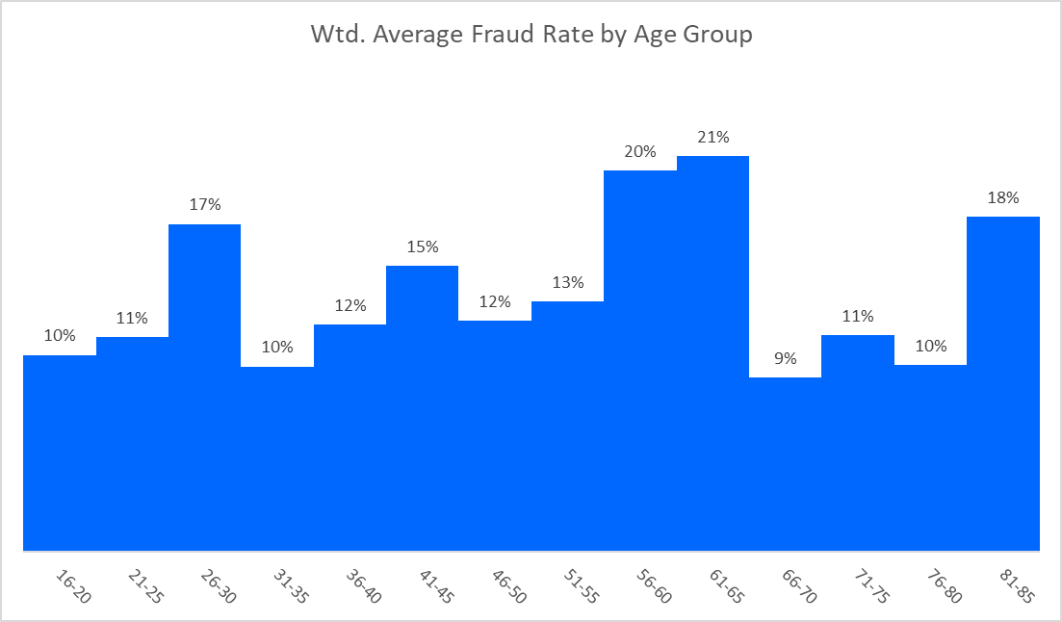
Looking into a few age groups with above average rates could be worthwhile
This is interesting, I would expect to see more fraud from younger groups

Slide 11
Device and Calendar Based Spikes
Sunday fraud rate is an outlier – 13.8% vs 7.5% average for other weekdays. And volume is sufficient to warrant a closer look
Device
73% of all traffic comes from mobile, but it accounts for %83 of fraud – a 10ppt over-index
OS
39% of all fraud comes from Android vs 33% of traffic overall. Moreover, 10% of Android traffic is fraudulent
Browser
There’s a spike in fraud during Dec – 11.5% vs 8% average for other months. However, Dec sample is small (~3% of data). This might normalize with larger sample.
Weekday
Month
19% of Safari traffic on mobile is fraudulent. Safari’s pct composition of fraud is 2x its pct composition of non-fraud
1
2
3
4
5

Slide 12
Key Take Aways
In summary, Persona’s automated solution is reasonably effective at catching fraud as 87% of the positive fraud observations were correctly classified. Barcodes are the best individual check. Regarding End Users, isolating day parts and unpacking device information is the likeliest means to effectively address fraud.

